Slide 1
Unmanned Aircraft System Security Model Survey
Matthew Whitesides
Professor Bruce M. McMillin
CS6600: Formal Methods in Computer Security

Slide 2
Outline
Unmanned Aircraft System Overview
Security Model Scenario
ACM & System Overview
Rights Leakage Findings
HRU
T-G
Security Classification Solutions
Q&A

Slide 3
Unmanned Aircraft System Overview
Unmanned Aircraft Systems (UAS) are air vehicles and associated equipment that do not carry a human operator.
They are instead are remotely piloted or fly autonomously.
Generally within an organization, a UAS can encompass the whole system of an unmanned aerial vehicle (UAV), control stations, command operations, maintenance systems, etc.

Slide 4
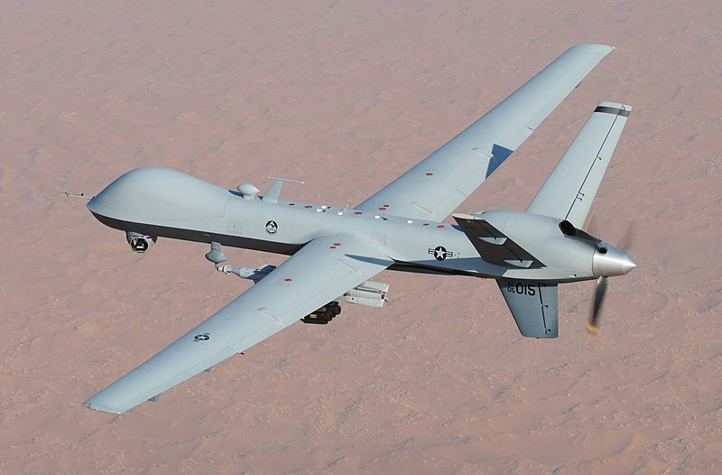
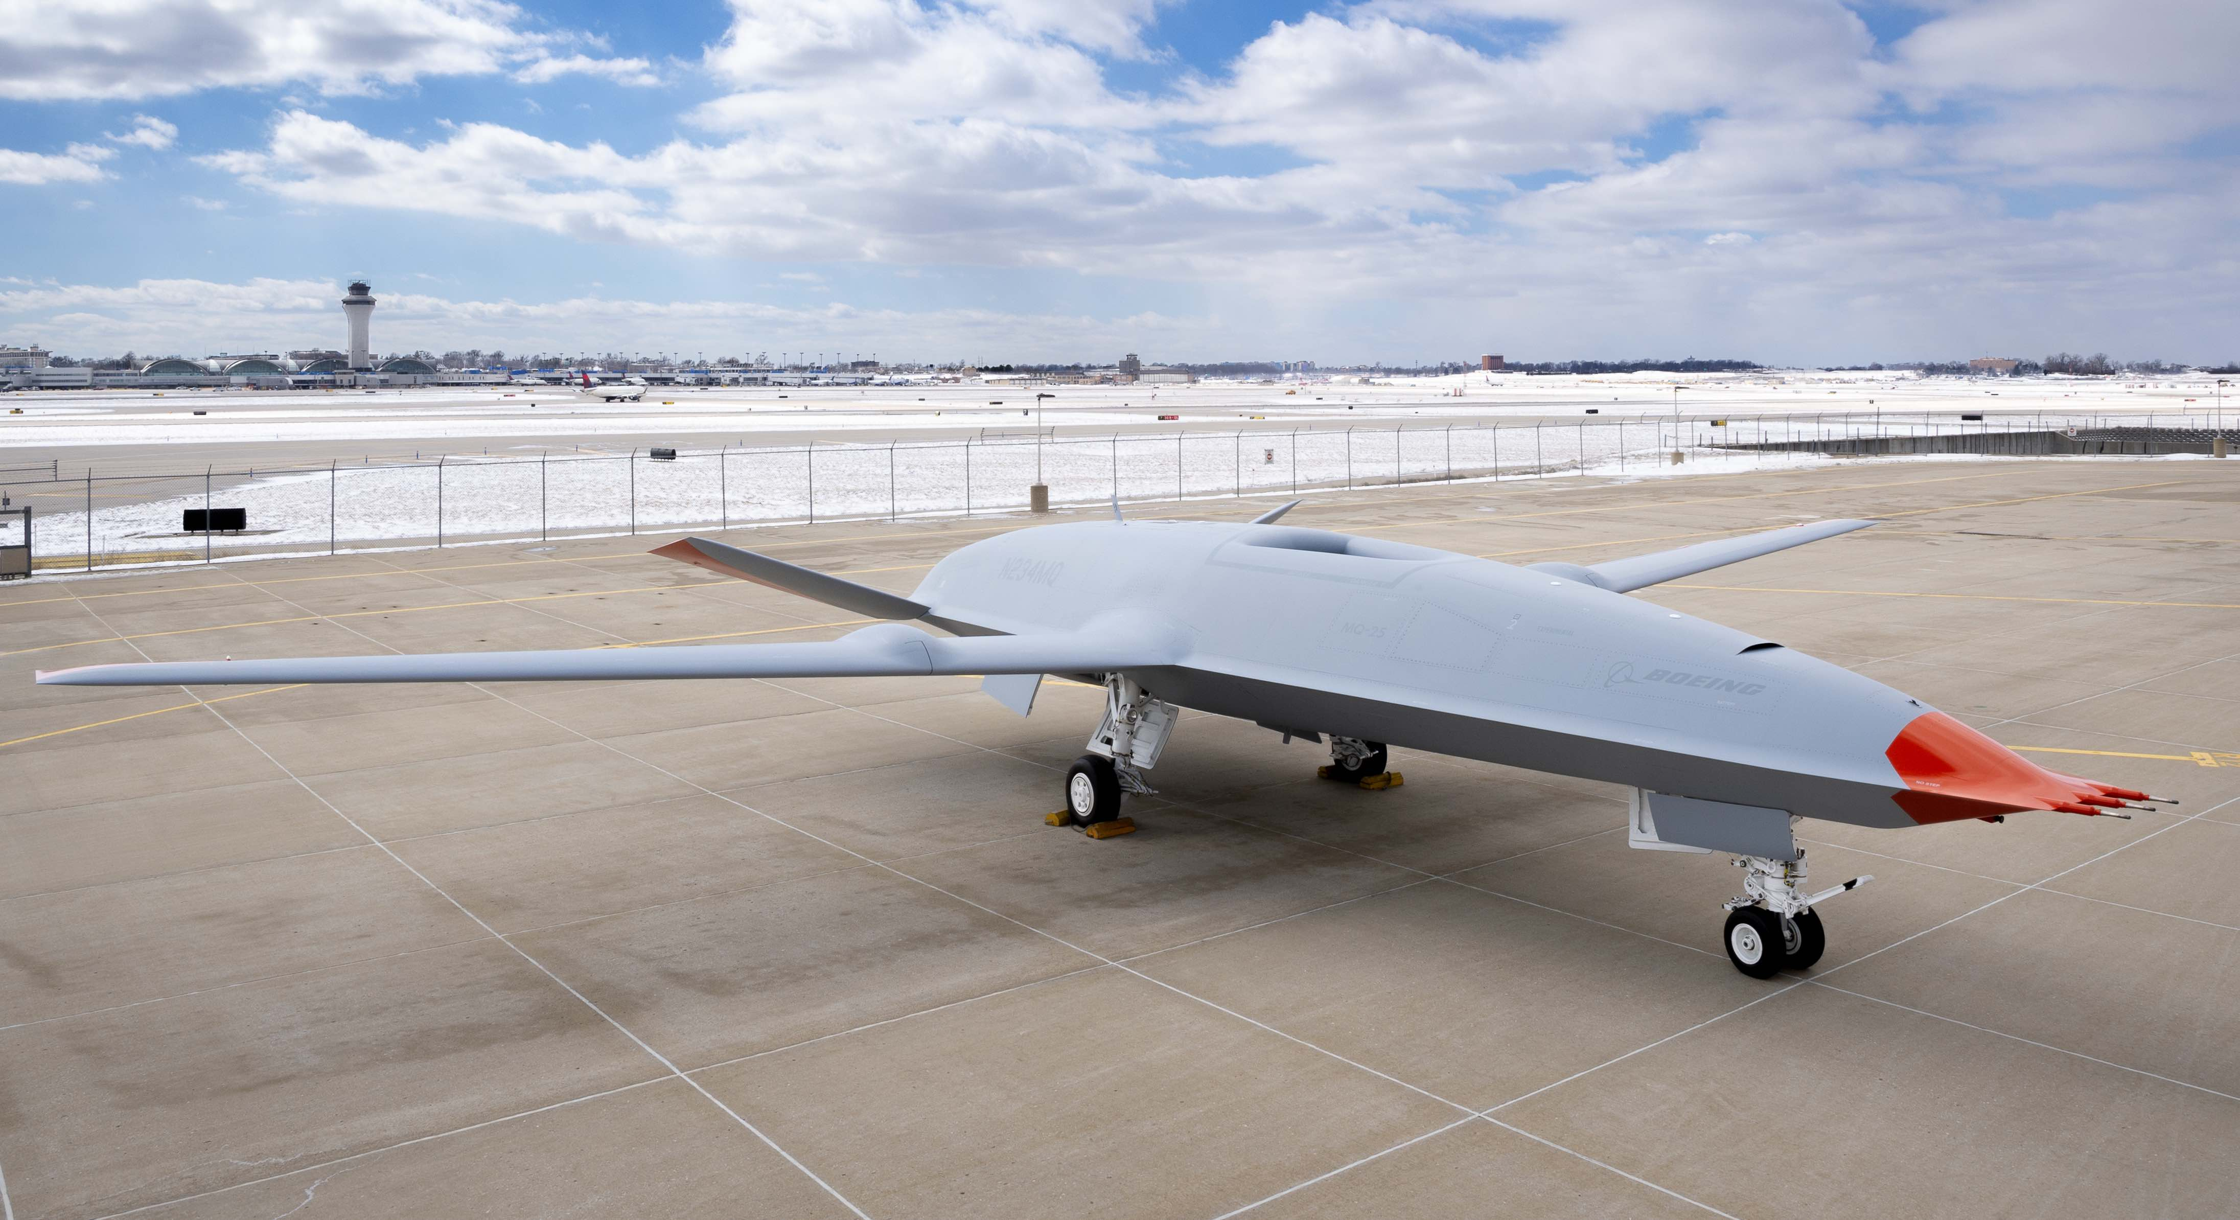
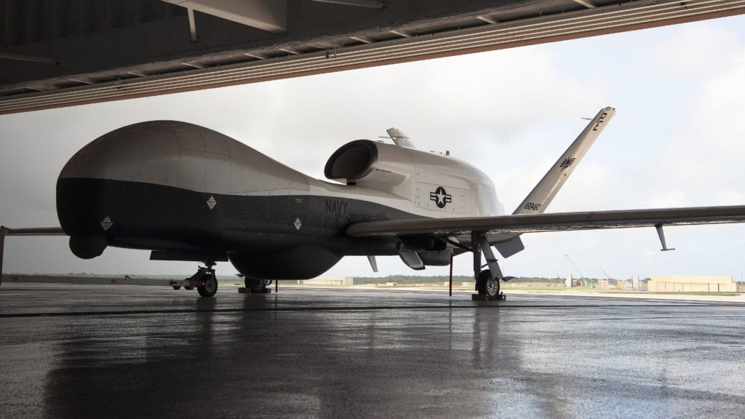
Unmanned Aircraft System Overview
Some examples of UAVs include:
General Atomics MQ-9 Reaper | Boeing MQ-25 Stingray | Northrop Grumman MQ-4C Triton

Slide 5
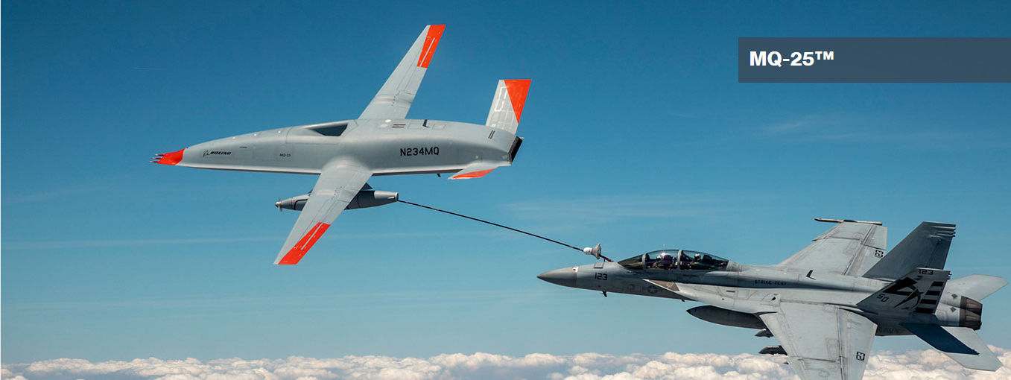
Unmanned Aircraft System Overview
For this security model simulation, we will take inspiration from an autonomous refueling aircraft.
These UAVs enable mid-flight refueling capabilities for larger aircraft to enable longer-range mission capabilities.
Boeing MQ-25
https://www.boeing.com/defense/mq25/

Slide 6
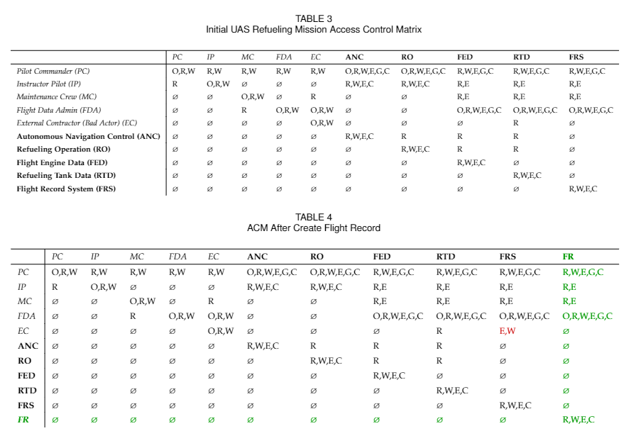
ACM & System Overview
Pilot Commander (PC): The primary remote pilot of the UAS during the mission.
Instructor Pilot (IP): Assists the Pilot Commander and can pilot the UAS if given permission from the PC or MC.
Maintenance Crew (MC): Handles work orders created by the PC, IP, or FDA, responsible for the maintenance of the UAS.
Flight Data Admin (FDA): Handles and analyses all mission flight data.
External Contractor (Bad Actor) (EC): Has a similar job to the MC however only has read rights to the FED.

Slide 7
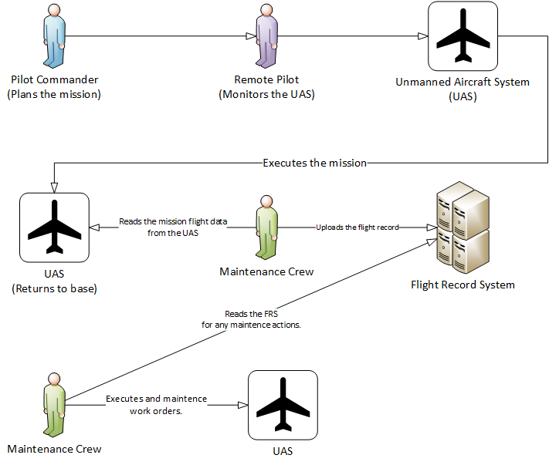
Security Model Scenario: Standard

Slide 8
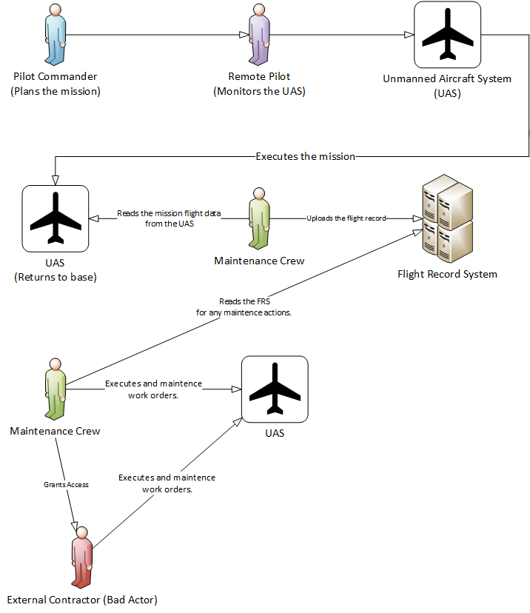
Security Model Scenario: Leakage

Slide 9
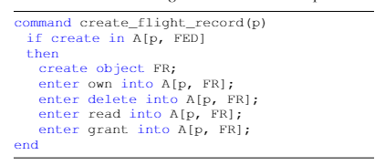
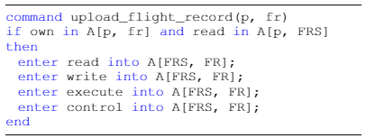
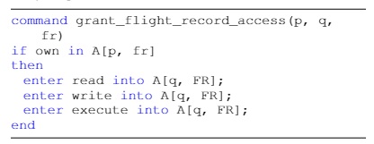
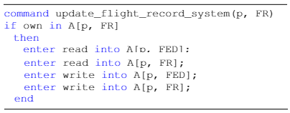
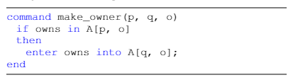
Integrity Rights Leakage: HRU
create_flight_record(Maintenance Crew (MC));
upload_flight_record(External Contractor (EC), Flight Record (FR));
grant_flight_record_access(Maintenance Crew, External Contractor (EC), Flight Record (FR));
make_owner(MC, EC, FR);
update_flight_record_system(EC, FR);

Slide 10
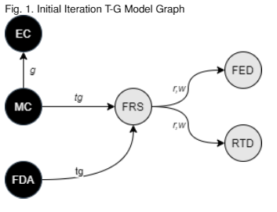
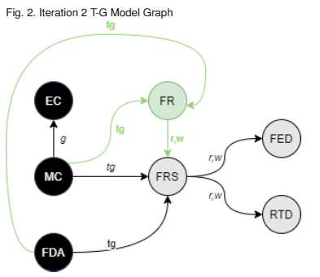
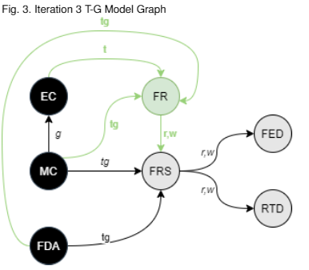
Confidentiality Rights Leakage: Take Grant
State after the EC leads the MC into giving them take rights over the FR they can exploit the system to take our leaked rights to FED through the FRS.
Initial State
State of rights after the MC runs the HRU command create_flight_record(MC) which a new FR object.

Slide 11
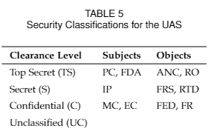
Biba Lipner Like: Security Classification Solutions
Given this is a military aircraft it makes sense to utilize existing government security clearance levels.
We then can further categorize
based upon job function.

Slide 12
Biba Lipner Like: Integrity Classification Solutions
We can now incorporate integrity categories to allow distinction between on aircraft systems and the flight record keeping system.
Ideally, these classifications would block EC from accessing FRS by putting them in a lower classification stopping our rights leakage. However, due to the requirement of MC to allow EC to read a flight record, our system would not operate otherwise.
Then integrity classifications to determine the trust of the data combing from that source.
Finally based upon work unit we can give a combined security and integrity level.

Slide 13
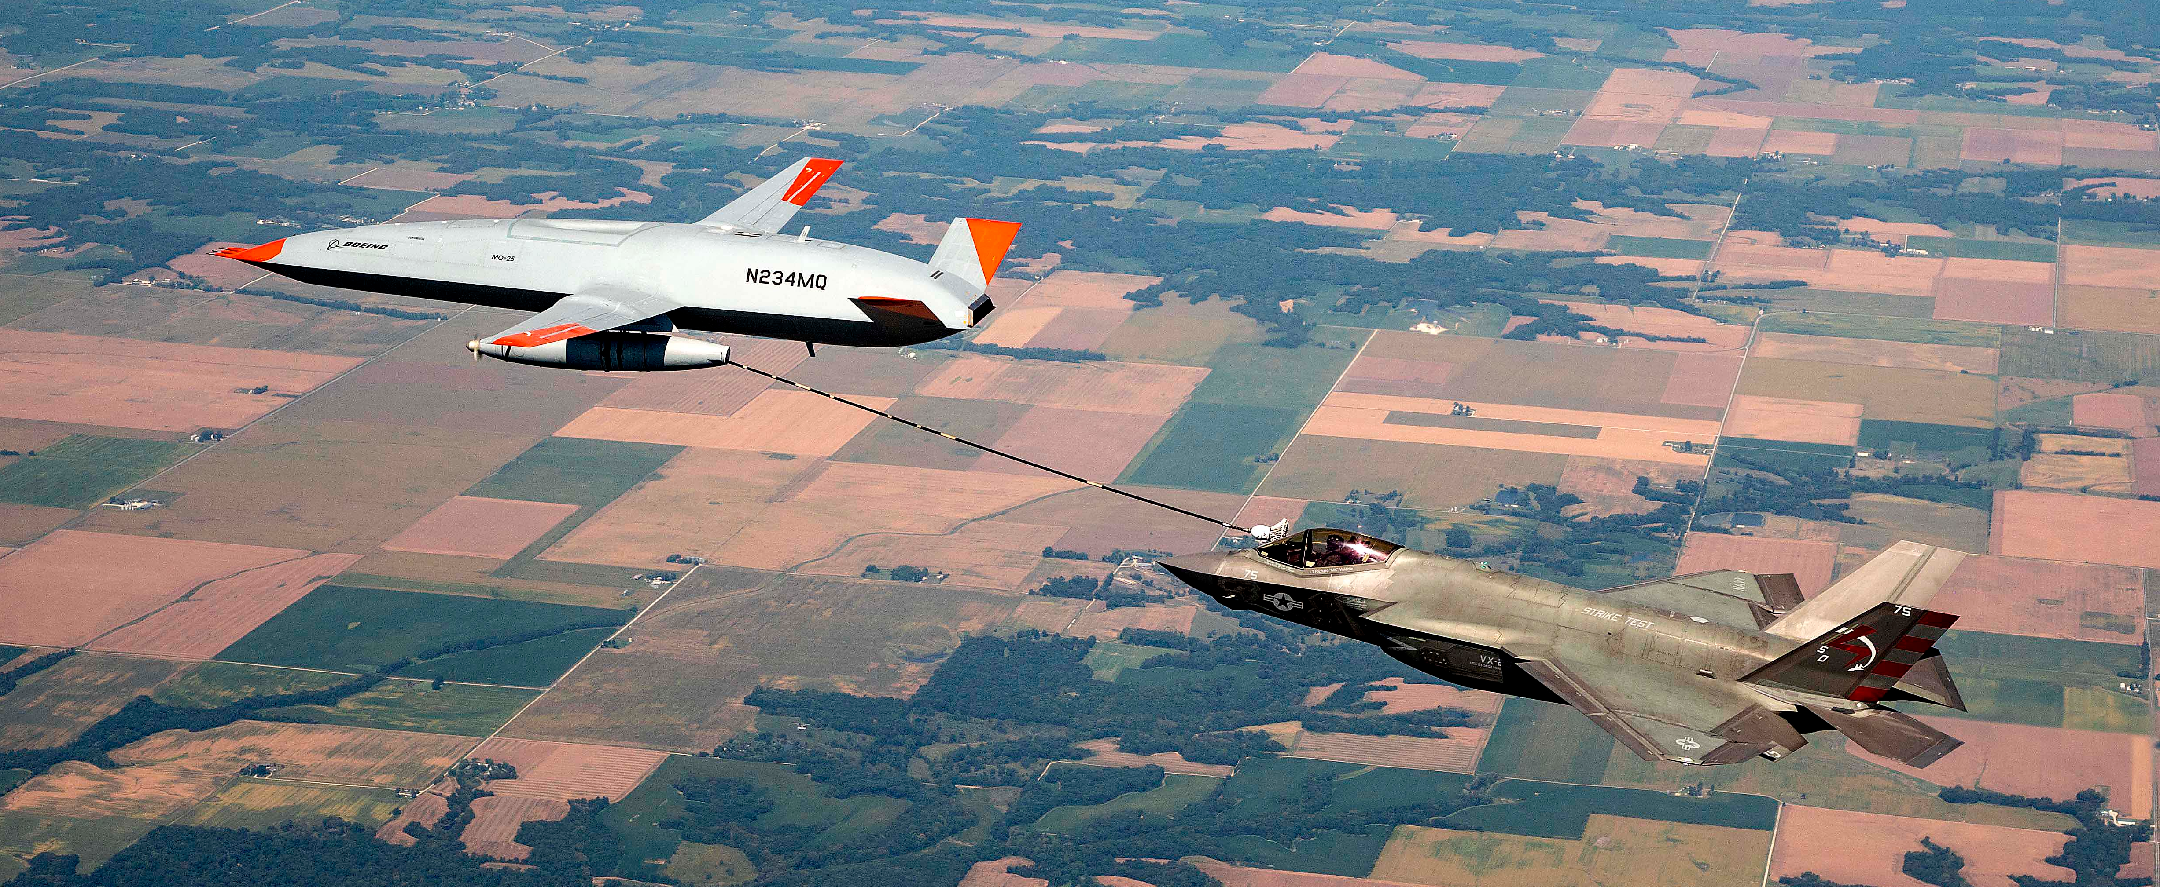
Q&A

